Slide 1

Unit-3 Protocols for IoT
IOT and Applications
GTU # 3160716
Prof. Tushar J. Mehta
Computer Engineering Department
tushar.mehta@darshan.ac.in
8866756776

Slide 2
Messaging Protocols
Section - 1

Slide 3
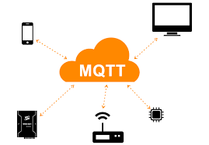
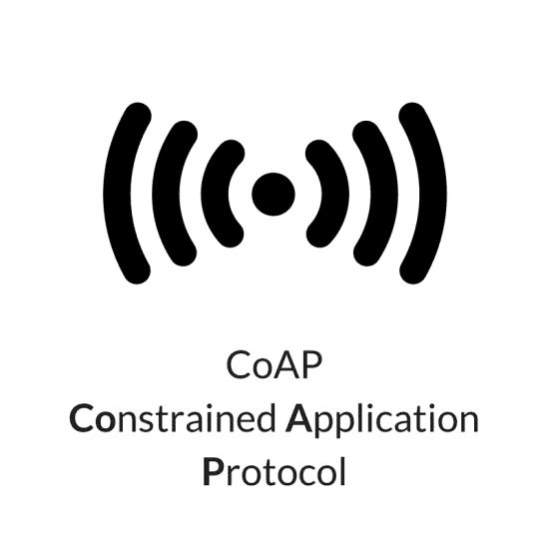

Messaging Protocols in IoT
Messaging protocols are very important for the transfer of data in terms of messages.
They are useful for send/receive of a message to/from the cloud in IoT applications.
In the section, two messaging protocols are discussed.
Message Queuing Telemetry Transport (MQTT)
Constrained Application Protocol (CoAP)

Slide 4


Message Queuing Telemetry Transport (MQTT)
As we know, IoT has one of the biggest challenges of resource constraints, the lightweight protocol is more preferred.
MQTT is widely used in IoT applications as it is a lightweight protocol.
Here, lightweight means, it can work with minimal resources and does not require any specific hardware architecture or additional resources.

Slide 5
MQTT
MQTT works with “publish – subscribe” pattern.
The MQTT working can be explained as follows.
The publisher (node) sends a message to the MQTT broker.
The MQTT broker transmits the message to the subscribed destinations.
Subscriber
Publisher
MQTT Broker
Subscriber

Slide 6


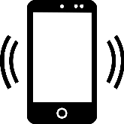

MQTT - Example
Suppose a temperature sensor is connected to any system and we want to monitor that temperature.
The controller connected to the temperature sensor publishes the temperature value to the MQTT broker with a topic name: “Temperature”. Hence, it is considered a publisher.
The MQTT broker transmits the temperature value to the subscribers.
Note that the only nodes which have subscribed to the topic will capture the data and not the other nodes.
Subscriber 1
Subscribed to:
“Temperature”
Subscriber 2
Publisher
MQTT Broker
Subscribed to:
“Temperature”
Subscriber 3

Slide 7


MQTT - Example
Can publisher and subscriber interchange their role?
Let us take an example of a Driverless car.
A GPS sensor is connected to the car which gives the current location of the car.
The system in car, publishes the location to MQTT broker with topic name – CurrentLocation.
The server/computer subscribes to the topic CurrentLocation and receives the current location of the car.
Publisher: CurrentLocation
MQTT Broker
Subscriber: CurrentLocation

Slide 8
MQTT - Example
Based on the currently selected destination, the server/computer computes the direction of the car.
This data is published to an MQTT broker with a topic named – Direction.
To get the command from the server, the system in the car has to subscribe to the topic named Direction.
According to the command received from the server, the car will run in a particular direction.
Publisher: CurrentLocation
MQTT Broker
Subscriber: CurrentLocation
Subscriber: Direction
Publisher: Direction

Slide 9


MQTT - Working
In MQTT, clients do not have any address like a typical networking scheme.
The broker filters the messages based on the subscribed topics.
The messages will then be circulated to respective subscribers.
The topic name can be anything in string format.
The MQTT working can be explained with an example of the television broadcast.
Client_Address

Slide 10



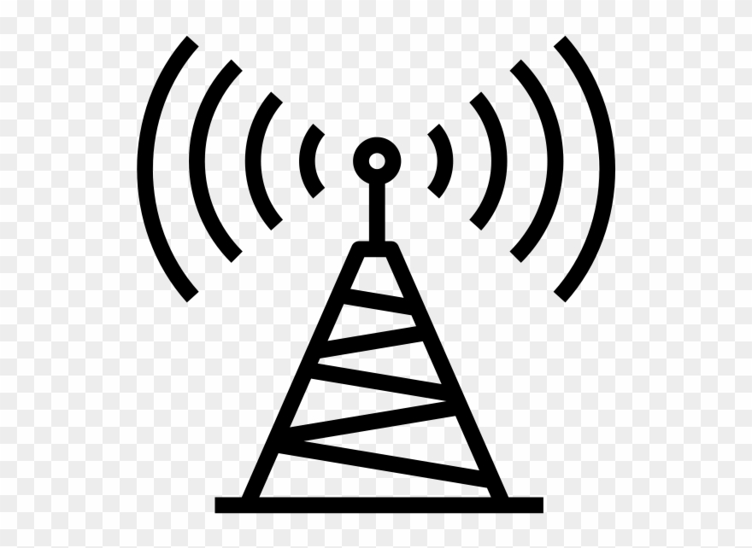

MQTT - Working
Television broadcaster station broadcasts all the channels.
The viewers subscribe to their favorite channels only.
Similarly, in MQTT, the publisher node publishes data with the topic name and interested subscribers subscribe to the topic.
Note that there can be multiple subscribers of a same topic as well as a single subscriber can subscribe to multiple topics.

Slide 11

MQTT – Node(s)
Node(s) in MQTT collects the information from sensors or other i/p devices in case of the publisher.
Connects it to the messaging server known as the MQTT broker.
A specific string – Topic is used to publish the message and let other nodes understand the information. These nodes are considered subscribers.
Any node can be publisher or subscriber and node is also referred to as client.
Publisher
MQTT
Broker
Subscriber
Topic:SensData

Slide 12
QoS in MQTT
MQTT supports different QoS (Quality of Service) levels.
There are 3 layers of QoS supported by MQTT.
Level 0 = At most once (Best effort, No Acknowledgement)
Level 1 = At least once (Acknowledged, retransmitted if ack not received)
Level 2 = Exactly once (Requested to send, clear to send)

Slide 13
MQTT Publisher – Code Implementation
The code for MQTT publisher is as shown in below.
MQTT_publisher.ino
Including the “ESP8266WiFi” library for enabling Wi-Fi connection with protocols.
1
2
3
4
5
6
7
8
9
10
11
12
13
#include <ESP8266WiFi.h>
#include <PubSubClient.h>
const char* ssid = "OnePlusTJ";
const char* pwd = "Tjm12347";
const char* mqtt_server =
"broker.mqtt-dashboard.com";
WiFiClient espClient;
PubSubClient client(espClient);
int value = 0;
unsigned long lastMsg = 0;
#define MSG_BUFFER_SIZE (50)
char msg[MSG_BUFFER_SIZE];
Including the “PubSubClient” library for use of MQTT protocol and their functions.
Defining parameters for Wi-Fi connection.
Defining MQTT server/broker for publishing the message on particular topic.

Slide 14
MQTT Publisher – Code Implementation
MQTT_publisher.ino
14
15
16
17
18
19
20
21
22
23
24
25
26
27
28
29
30
void setup_wifi() {
delay(10);
Serial.println();
Serial.print("Connecting to ");
Serial.println(ssid);
WiFi.mode(WIFI_STA);
WiFi.begin(ssid, pwd);
while(WiFi.status()!=WL_CONNECTED) {
delay(500);
Serial.print(".");
} Serial.println("WiFi connected");
Serial.println("IP address: ");
Serial.println(WiFi.localIP());
}
Initializing Wi-Fi module as station mode.
Connecting Wi-Fi module with given SSID and Password
Try until Wi-Fi is not connected to given SSID with delay of half second.

Slide 15
MQTT Publisher – Code Implementation
MQTT_publisher.ino
31
32
33
34
35
36
37
38
39
40
41
42
43
void setup() {
Serial.begin(115200);
setup_wifi();
client.setServer(mqtt_server,1883);
while (!client.connected()) {
Serial.print("Attempting MQTT");
String clientId="ESPClient1234";
if (client.connect(
clientId.c_str())) {
Serial.println("connected");
client.publish("darshan/6thsem /ce", “You are in Darshan");
}
}
}
Connects the client to the MQTT Server stored in mqtt_server with port number 1883.
Execute the syntax in loop until ESP is not connected to MQTT broker.
Defining a clientId for MQTT server/broker.
Returns the pointer of string clientId to the array.
Publishing announcement message after connecting to the MQTT broker with Topic name : darshan/6thsem/ce

Slide 16
MQTT Publisher – Code Implementation
MQTT_publisher.ino
44
45
46
47
48
49
50
51
52
53
54
55
56
57
58
void loop() {
client.loop();
unsigned long now = millis();
if (now - lastMsg > 2000)
{
lastMsg = now;
++value;
snprintf (msg, MSG_BUFFER_SIZE, "hello world #%ld", value);
Serial.print("Publish message:");
Serial.println(msg);
client.publish("darshan/6thsem/
ce", msg);
}
}
This function allows client to process incoming messages, publish data and refresh the connection.
Creating a string in msg with given buffer size and assigning the value “hello world” with concatenation of integer named value.
Publishes the msg in the given topic name: darshan/6thsem/ce

Slide 17
MQTT Subscriber – Code Implementation
The code for MQTT subscriber is as shown in below.
MQTT_subscriber.ino
Including the “ESP8266WiFi” library for enabling Wi-Fi connection with protocols.
1
2
3
4
5
6
7
8
9
#include <ESP8266WiFi.h>
#include <PubSubClient.h>
const char* ssid = "OnePlusTJ";
const char* pwd = "Tjm12347";
const char* mqtt_server =
"broker.mqtt-dashboard.com";
WiFiClient espClient;
PubSubClient client(espClient);
Including the “PubSubClient” library for use of MQTT protocol and their functions.
Defining parameters for Wi-Fi connection.
Defining MQTT server/broker for publishing the message on particular topic.

Slide 18
MQTT Subscriber – Code Implementation
MQTT_subscriber.ino
10
11
12
13
14
15
16
17
18
19
20
21
22
23
24
25
26
void setup_wifi() {
delay(10);
Serial.println();
Serial.print("Connecting to ");
Serial.println(ssid);
WiFi.mode(WIFI_STA);
WiFi.begin(ssid, pwd);
while(WiFi.status()!=WL_CONNECTED) {
delay(500);
Serial.print(".");
} Serial.println("WiFi connected");
Serial.println("IP address: ");
Serial.println(WiFi.localIP());
}
Initializing Wi-Fi module as station mode.
Connecting Wi-Fi module with given SSID and Password
Try until Wi-Fi is not connected to given SSID with delay of half second.

Slide 19
MQTT Subscriber – Code Implementation
MQTT_subscriber.ino
27
28
29
30
31
32
33
34
35
36
37
void callback(char* topic,
byte* payload, unsigned int length) {
Serial.print("Message arrived [");
Serial.print(topic);
Serial.print("] ");
for (int i = 0; i < length; i++)
{
Serial.print((char)payload[i]);
}
Serial.println();
}
A callback function for receiving messages every time when client.loop( ) executes.
This function accepts the arguments char* of topic, char* of payload and the length of payload.
Executing the for loop until all the characters of the payload are printed.
Typecasting of payload[i] into equivalent character and then printing on serial monitor.

Slide 20
MQTT Subscriber – Code Implementation
MQTT_subscriber.ino
38
39
40
41
42
43
44
45
46
47
48
49
50
51
52
53
54
void setup() {
Serial.begin(115200);
setup_wifi();
client.setServer(mqtt_server,1883);
client.setCallback(callback);
while (!client.connected()) {
Serial.print("Attempting MQTT");
String clientId="ESPClient1234";
if (client.connect(
clientId.c_str())) {
Serial.println("connected");
client.subscribe("darshan/Msg");
}
}
}
void loop() {
client.loop(); }
This is built-in function client.setCallback( ) in PubSubClient library and it calls a function callback( ) every time when client.loop( ) function is executed.
Subscribing to the Topic named “darshan/Msg”

Slide 21
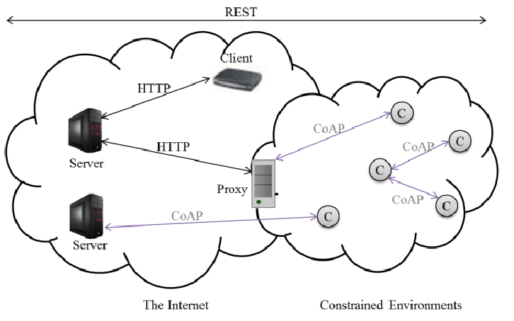
Constrained Application Protocol (CoAP)
CoAP is designed by IETF (Internet Engineer Task Force) to work in constrained environment.
It is a one to one communication protocol.
CoAP is also light weight like MQTT protocol and it uses less resources than HTTP.
HTTP runs over TCP and is connection oriented while CoAP runs over UDP and it is connection less.

Slide 22
CoAP Architecture
CoAP is based on the RESTful architecture (Representational State Transfer).
REST approach ensures the secure, fault tolerant and scalable system.
The CoAP optimizes the length of the datagram.
CoAP is connectionless protocol and it requires retransmission support.

Slide 23
CoAP Layers
CoAP has four layers:
UDP
Messages
Request-Response
Application
The message layer is designed to deal with UDP and asynchronous switching.
The request/response layer concerns communication method and deal with request/response messages.
In the request/response layer, clients may use GET/PUT/DELET methods to transmit the message.
Application
Request/Response
Messages
UDP

Slide 24
Message Layer in CoAP
CoAP message layer supports four types of messages:
Confirmable – Reliable Messaging (CON):
This is reliable approach because the retransmission of message occurs until the acknowledgement of the same message ID is received.
If there is a timeout or fail of acknowledgement, the RST message will be sent from the server as a response.
Hence, the client will retransmit the message, this resolves the retransmission and it is considered a reliable approach.
Client
Server
CON (ADDR)

Slide 25
Message Layer in CoAP (Contd.)
Non-confirmable – Non-reliable Messaging (NON):
In this message transmission style, there is no reliability is ensured.
The acknowledgement is not issued by the server.
The message has ID for supervision purpose, if the message is not processed by the server it transmits the RST message.
Client
Server
NON [Message ID]

Slide 26
Message Layer in CoAP (Contd.)
Acknowledgement (ACK):
In this messaging, the traditional acknowledgement message sent as usual protocol.
We can compare this with regular handshaking scheme.
The handshake is automated process that establishes a link for communication before actual data transfer begins.
Client
Server
CON (ADDR)
ACK (ADDR)

Slide 27
Message Layer in CoAP (Contd.)
Reset (RST):
The receiver is expecting the message from sender of a particular message ID.
If no message is processed or received before specific amount of time (called timeout), the message called RESET is transmitted from receiver.
This message informs the sender that there is a trouble in transmission of messages.
Client
Server
CON (ADDR)
Timeout
RST

Slide 28
Request-Response Layer in CoAP
There are three modes in CoAP request-response layer.
Piggy-Backed:
In this mode, the client sends the data with particular method (GET, PUT etc.) with token number and CON messaging method.
The ACK is transmitted by server immediately with corresponding token number and message.
If the message is not received by server or data is not available then the failure code is embedded in ACK.
Client
Server
Client
Server
CON (ADDR)
GET/Humidity
(Token Number)
CON (ADDR)
GET/Humidity
(Token Number)
ACK (ADDR)
(Token Number)
72%
ACK (ADDR)
(Token Number)
NOT FOUND

Slide 29
Request-Response Layer in CoAP (Contd.)
Separate Response:
In this mode, the client sends the data with particular method (GET, PUT etc.) with token number and CON messaging method.
If the server is unable to respond immediately, an empty ACK will be reverted.
After some time, when the server is able to send the response, it sends a CON message with data.
In response to that, ACK is sent back from client to server.
Client
Server
CON (ADDR)
GET/Humidity
(Token Number)
ACK
.
.
.
.
CON (ADDR)
(Token Number)
60%
ACK

Slide 30
Request-Response Layer in CoAP (Contd.)
Non-Confirmable Request and Response:
In this mode, the client sends the data with particular method (GET, PUT etc.) with token number and NON messaging method.
The server does not give ACK in NON messaging method, so it will send a NON type response in return with token number and its data.
Client
Server
NON (Message ID)
GET/Humidity
(Token Number)
NON (Message ID)
(Token Number)
72%

Slide 31
CoAP Message Format
The CoAP message format is of 16 Bytes consisting various fields.
V : It refers to version of CoAP. It is two bit unsigned integer.
T : It refers to message type. It is also two bit unsigned integer.
Confirmable (0)
Non-Confirmable (1)
ACK (2)
RESET (3)
TKL : It refers to the token length and is four bit unsigned integer.
Code: It refers to the response code.
0 | 1 | 2 | 3 | 4 | 5 | 6 | 7 | 8 | 9 | 10 | 11 | 12 | 13 | 14 | 15 | 16 | 17 | 18 | 19 | 20 | 21 | 22 | 23 | 24 | 25 | 26 | 27 | 28 | 29 | 30 | 31
V | T | TKL | Code | Message ID
Token (if any, with TKL bytes length)
Options (if any)
1 | 1 | 1 | 1 | 1 | 1 | 1 | 1 | Payload

Slide 32
CoAP Message Format (Contd.)
Message ID: It is identifier of the message and to avoid duplication.
Token : Optional field whose size is indicated by the Token Length field.
Options : This field is used if any options available and having length of 4 Bytes.
Payload : This field refers to the payload data where actual data is transmitted.
0 | 1 | 2 | 3 | 4 | 5 | 6 | 7 | 8 | 9 | 10 | 11 | 12 | 13 | 14 | 15 | 16 | 17 | 18 | 19 | 20 | 21 | 22 | 23 | 24 | 25 | 26 | 27 | 28 | 29 | 30 | 31
V | T | TKL | Code | Message ID
Token (if any, with TKL bytes length)
Options (if any)
1 | 1 | 1 | 1 | 1 | 1 | 1 | 1 | Payload

Slide 33


XMPP Protocol
The full form of XMPP is Extensible Messaging and Presence Protocol.
It is designed for messaging, chat, video, voice calls and collaboration.
The fundamental base of this protocol is XML and it is used for messaging services such as WhatsApp.
The XMPP was originally named as Jabber and later known as XMPP.

Slide 34
XMPP denotation
The denotation for XMPP can be given as following:
X – X denotes eXtensible.
It is considered extensible as it is designed to accept and accommodate any changes.
The protocol is defined in open standard and it is extensible because of open standard approach.
M – M denotes Messaging.
XMPP supports sending message to the recipients in real time.
P – P denotes Presence.
It is helpful to identify the status such as “Offline” or “Online” or “Busy”.
It also helps in understanding if the recipient is ready to receive the message or not.
P – P denotes Protocol.
The set of standards together acting as a protocol.

Slide 35
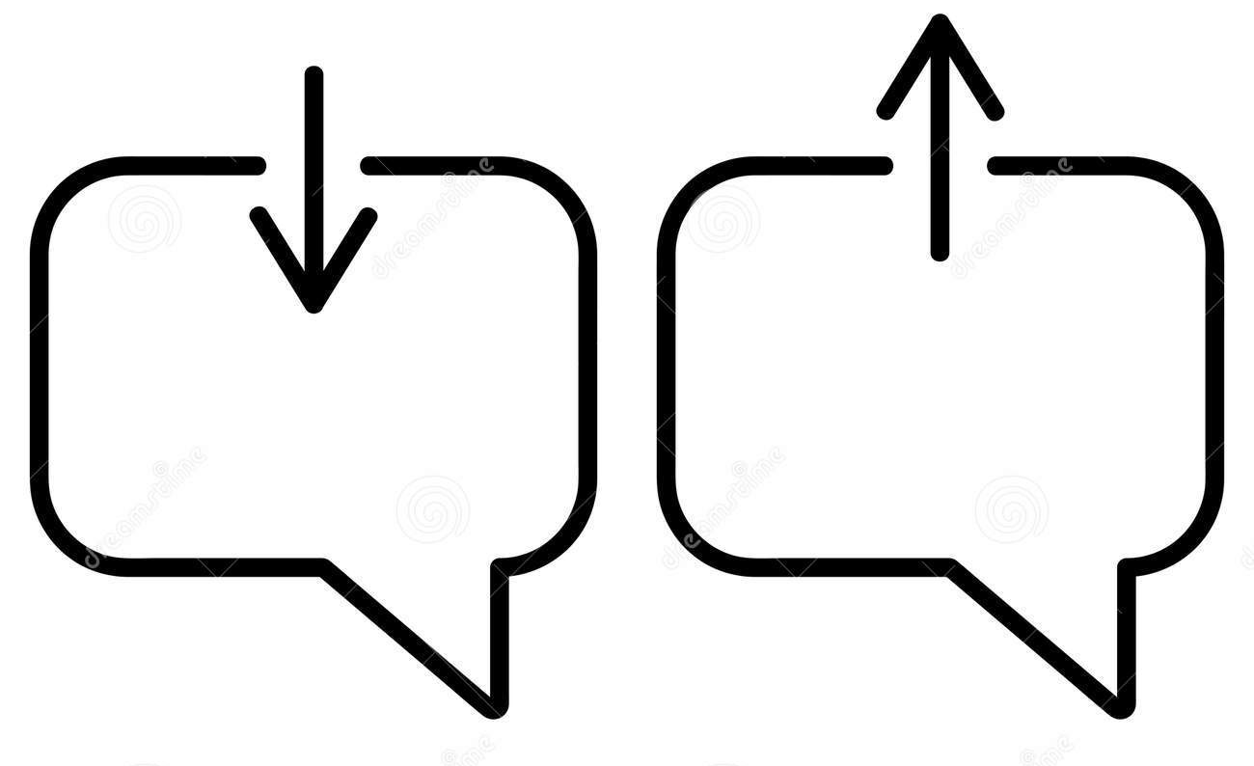




Messenger Requirements
Any messenger requires the following features inbuilt :
Message sending and receiving features.
Understanding the presence/absence status.
Managing subscription details.
Maintaining the contact list.
Message blocking services.
Note that all the listed features are built in XMPP.

Slide 36
XMPP Architecture
The architecture of XMPP protocol is shown in the figure :
The XMPP clients communicate with XMPP server bidirectional.
There can be any numbers of clients connected to XMPP server.
The XMPP servers may be connected to the other clients or other XMPP servers.
XMPP
Client
XMPP
Client
XMPP
Client
XMPP
Server
XMPP
Server
XMPP
Client
XMPP
Client
XMPP
Client

Slide 37
XMPP Architecture (Contd.)
The initial version of the XMPP was with TCP using open ended XML.
After certain period of time, the XMPP was developed based on HTTP.
The XMPP can work with HTTP is through two different methods Polling and Binding.
What is Polling and Binding?
XMPP
Client
XMPP
Client
XMPP
Client
XMPP
Server
XMPP
Server
XMPP
Client
XMPP
Client
XMPP
Client

Slide 38
XMPP Architecture (Contd.)
In polling method, the messages stored in the server are pulled or fetched.
The fetching is done by XMPP client through HTTP GET and POST requests.
In binding method, Bidirectional-streams Over Synchronous HTTP (BOSH) enables the server to push the messages to the clients when they are sent.
The binding approach is more effective than polling.
Also both method uses HTTP, hence the firewall allows the fetch and post activity without any difficulties.

Slide 39


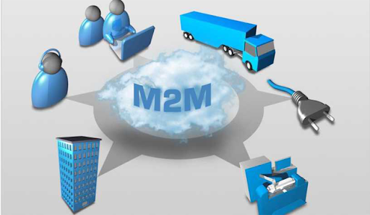
Data Distribution Service (DDS)
Data Distribution Service (DDS) is one of the protocol being used in the Internet of Things (IoT) applications.
DDS is brokerless service and the protocol was developed by the Object Management Group (OMG).
The purpose behind development of DDS is to get better machine to machine communication.
Like MQTT, DDS is also using publish-subscribe approach.

Slide 40
DDS Architecture
DDS is basically a publish – subscribe model based architecture.
Everything including sending and receiving data, event updates, command within and among the nodes are all accomplished through the publish – subscribe approach.
The publisher sends the data to DDS cloud with particular Topic.
The interested nodes (Subscribers) subscribes the particular Topic and receives data from DDS Cloud.
Publisher
Data Distribution Service
(DDS)
Subscriber
Publisher
Subscriber
Publisher
Subscriber

Slide 41
DDS Architecture (Contd.)
Here, DDS Cloud has to handle all the attributes of data transfer like addressing, marshalling data, control of delivery, control of flow, etc.
The marshalling of data means to convert any data or objects into a byte-stream, while unmarshalling is exactly the reverse process.
This enables the communication between publisher and subscriber working on multiple different platforms.
Publisher
Data Distribution Service
(DDS)
Subscriber
Publisher
Subscriber
Publisher
Subscriber

Slide 42
Transport Protocols
Section - 2

Slide 43


Bluetooth 4.0 (BLE)
BLE – Bluetooth Low Energy
BLE is open low energy short range radio communication technology.
The BLE is also known as Bluetooth Smart.
This protocol is designed by Bluetooth Special Interest Group (SIG).
BLE also works same al Bluetooth in wireless Personal Area Network (PAN).
It can be considered the advanced version of Bluetooth.

Slide 44





Bluetooth 4.0 (BLE) (Cont.)
BLE is superior to classic Bluetooth because of following reasons:
It is power saving.
It is supported by Android, IOS, Blackberry, etc.
It is also supported by computer OS like Windows 8/10, MAC-OS, and Linux variants.
Because of certain advantages of BLE over classic Bluetooth, it is widely used in the areas like:
Healthcare
Entertainment
Fitness (in form of wearable devices)
Proximity related applications
Tracking devices

Slide 45



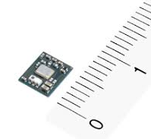


Features of BLE
The key features of BLE are as following:
It is licence free and does not add any overhead costing.
There is no restrictions to Manufacturer.
BLE modules are inexpensive and affordable.
The size of BLE modules are small. So it can be accommodated in any system easily.
The power consumption for BLE modules is very less and hence suitable for IoT applications.
The range of BLE has very high range compared to classic Bluetooth.

Slide 46
BLE Architecture
The BLE architecture has three components.
Application Block
The user application is accommodated in this block.
It interacts directly with Bluetooth stack.
Host Block
It is upper layer of the Bluetooth stack.
Controller Block
It is lower layer of the Bluetooth stack.
BLE
Application
Controller
Host

Slide 47
Application
Application
Generic Access Profile
(GAP)
Generic Attribute Profile
(GATT)
Host
Security Management Protocol
(SMP)
Attribute Protocol
(ATT)
Logical Link Control and Adaptation Protocol
(L2CAP)
--------------------------------------Host Controller Interface --------------------------------------
(HCI)
Link Layer (LL)
Controller
Physical Layer (PHY)

Slide 48
BLE Architecture
Controller : It has three components.
Host Controller Interface (HCI) : is used to enable interoperability between hosts and controllers assembled by different manufacturers
Link Layer (LL) : It defines the packet structure
Physical Layer (PHY) : It takes care of the transmission/reception, modulation/demodulation and analog-to-digital conversion.
--------------------------------------Host Controller Interface --------------------------------------
(HCI)
Link Layer (LL)
Controller
Physical Layer (PHY)

Slide 49
BLE Architecture
Host : It has following components with functionalities
Generic Access Profile (GAP) : It takes care of the device discovery, connection establishment, connection management and security.
Generic Attribute Profile (GATT) : It is responsible for the data exchange process. Whenever there is a need to push data and to read or write data, the generic guidelines with respect to the process are governed by GATT.
Attribute Protocol (ATT) : It is the protocol for accessing data.
Generic Access Profile
(GAP)
Generic Attribute Profile
(GATT)
Host
Security Management Protocol
(SMP)
Attribute Protocol
(ATT)
Logical Link Control and Adaptation Protocol
(L2CAP)

Slide 50
BLE Architecture
Host : It has following components with functionalities
Logical Link Control and Adaptation Protocol (L2CAP) : It is responsible for fragmentation and de-fragmentation of the application data. Also, it is responsible for the multiplexing and de-multiplexing of channels over the shared logical link.
Security Manager (SM) : It takes care of pairing, authentication, and encryption. Everything related to security is taken care here.
Host Controller Interface (HCI) : The functionality remains the same as that in the controller. It is used to enable interoperability between hosts and controllers assembled by different manufacturers.
Generic Access Profile
(GAP)
Generic Attribute Profile
(GATT)
Host
Security Management Protocol
(SMP)
Attribute Protocol
(ATT)
Logical Link Control and Adaptation Protocol
(L2CAP)

Slide 51
BLE Architecture
Application Layer :
The working of application layer in BLE is same as in OSI model. It is the top most layer in BLE and this layer is responsible for user interface (UI), logic and data handling.
Application
Application

Slide 52
BLE Topology
Broadcasting
The meaning of broadcasting is to send a message to more than one recipient. The same concept is followed in BLE.
The broadcast method will send the data in “one way” only.
The receiver in the vicinity of the broadcaster will receive the message or data.
There are two parts in broadcasting topology. Broadcaster and Observer.
Observer
Observer
Observer
Bluetooth
Broadcaster
Observer
Observer
Observer

Slide 53
BLE Topology
Broadcasting
Broadcaster : The broadcaster sends a "non-connectable" advertising packets in frequent intervals to all those who are willing to collect which is similar to a radio broadcast.
Observer : The observer will keep scanning predefined frequency to receive any non-connectable packets..
Observer
Observer
Observer
Bluetooth
Broadcaster
Observer
Observer
Observer

Slide 54
BLE Topology
Connections
The connections topology works on the concept of master-slave configuration.
The master will try to find out the connectable advertising packets. Once the advertisement is found, it will initiate the connection to the slave.
The master will take care of periodic data exchange.
The slave(s) continuously sends the connectable advertising packets at regular interval.
Slave
(Peripheral)
Slave
(Peripheral)
Slave
(Peripheral)
Master
Slave
(Peripheral)
Slave
(Peripheral)
Slave
(Peripheral)

Slide 55
BLE Topology
Connections
Once the slave is connected, the event is called connection event.
In this topology, the device will work whenever required. For the remaining time the device is in sleep mode.
This provides power saving during the communication.
However, during the sleep mode also the connection remains present.
But the data will be transferred after the device invokes.
Slave
(Peripheral)
Slave
(Peripheral)
Slave
(Peripheral)
Master
Slave
(Peripheral)
Slave
(Peripheral)
Slave
(Peripheral)

Slide 56

Light Fidelity (Li-Fi)
The Li-Fi is fastest communication protocol right now among all existing protocols.
The symbol of Li-Fi is as shown in the figure.
It gives the following solutions to the problems which one can face during the use of the Wi-Fi.
More security than Wi-Fi.
More available bandwidth to the connected devices or equipments.
Less/No congestion when more number of devices connected.
Note that the Li-Fi has phenomenal speed of 224GBps which is fastest among all.

Slide 57




Li-Fi Working
The server wants to transmit the data to the receiver with very high speed. The server is either connected to internet or intranet.
The server connected to the internet generates a data which is converted into streaming content.
The streaming content is given to Lamp driver which is powered by external source.
Streaming
Content
Lamp
Driver
Server
LED
Lamp
LED
Lamp
Internet
Power
Receiver dongle
Photo
Detector
Receiver dongle
Photo
Detector
Received App Data
Amplification & Processing
Received App Data
Amplification & Processing

Slide 58
Li-Fi Working
The LED lamp is turned on and off at very high speed that human eyes can not capture it.
The light is received by the photo detector and it is passed for demodulation process and amplification to generate the data stream sent by transmitter.
The received data stream is further given to receiver (e.g. mobile, PC etc.) via receiver app. All components working for receiving the data combined known as receiver dongle.
Streaming
Content
Lamp
Driver
Server
LED
Lamp
LED
Lamp
Internet
Power
Receiver dongle
Photo
Detector
Receiver dongle
Photo
Detector
Received App Data
Amplification & Processing
Received App Data
Amplification & Processing

Slide 59
Li-Fi – Advantages & Disadvantages
Advantages
Li-Fi is extremely secure as the light can not penetrate through walls and no data hijacking is possible.
Li-Fi is fastest and effective.
It is an effective alternate to RF communication.
It is inexpensive as the light is generated through LED lamps.
Disadvantages
It can be implemented in short range as the presence of walls or any other object will become the interruption in communication.
The required time for set up is higher.
There is no clarity of bidirectional communication means how to send data from mobile or PC back to server.

Slide 60
Addressing & Identification Protocols
Section - 3

Slide 61
Internet Protocol Version 4 (IPv4)
IP addresses are useful in identifying a specific host in a network.
IP addresses are 32 bit numbers which are divided into 4 octets. Each octet represents 8 bit binary number.
Below is an example of an IP address:
10101100
00010000
11111110
00000001
172
16
254
1
IP addresses are divided into 2 parts:
Network ID & Host ID
<NID> <HID> = IP Address

Slide 62
Classification of IP Address
Class: A
0
7 Bit Network ID
24 Bit Host ID
Fix
Class: B
1 | 0
Fix
14 Bit Network ID
16 Bit Host ID
Class: C
1 | 1 | 0
Fix
21 Bit Network ID
8 Bit Host ID
Class: D
1 | 1 | 1 | 0
Fix
Class: E
Multicast address
1 | 1 | 1 | 1
Fix
Reserved address

Slide 63
Class A
0
Only 126 addresses are used for network address.
All 0’s and 1’s in Network-ID are dedicated for special IP address. So, total number of IP address in class A can be represented as following.
The range of Class A is 0.0.0.0 to 127.255.255.255
7 Bit Network ID
24 Bit Host ID
0.0.0.0 | Special IP Address
00000001.0.0.1 1.0.0.2 1.0.0.3 . . . 126.255.255.254 | 2²⁴ – 2 are Host IP
127.255.255.255 | Special IP Address – Loopback

Slide 64
Class B
No special network address here. All are usable.
The total number of hosts connected in network can be given as following:
It is used in medium size network.
The range of Class B is 128.0.0.0 to 191.255.255.255
1 | 0
Fix
14 Bit Network ID
16 Bit Host ID
128.0.0.0 | Special IP Address
10000001.0.0.1 130.0.0.2 130.0.0.3 . . . 190.255.255.254 | 2¹⁶ – 2 are Host IP
10111111.255.255.255 | Special IP Address – Loopback

Slide 65
Class C
This class is used in small networks.
The calculation for number of hosts can be given as following:
Normally, the LANs are configured with Class C.
The range for Class C is given as 192.0.0.0 to 223.255.255.255
1 | 1 | 0
Fix
21 Bit Network ID
8 Bit Host ID
192.0.0.0 | Special IP Address
11000001.0.0.1 194.0.0.2 194.0.0.3 . . . 222.255.255.254 | 2⁸ – 2 are Host IP
11011111.255.255.255 | Special IP Address – Loopback

Slide 66
Class D
Very first four bits of the first octet in Class D IP addresses are set to 1110, giving a range of:
Class D has IP address rage from 224.0.0.0 to 239.255.255.255.
Class D is reserved for Multicasting.
In multicasting data is not destined for a particular host, that is why there is no need to extract host address from the IP address, and Class D does not have any subnet mask.
11100000 – 11101111
224 – 239

Slide 67
Class E
This IP Class is reserved for experimental purposes only for R&D or Study.
IP addresses in this class ranges from 240.0.0.0 to 255.255.255.254.
Like Class D, this class too is not equipped with any subnet mask.

Slide 68
IPv4 Format
Figure shows the format for IPv4.
VER (Version):
It is a 4 bits field which indicates the version of IP.
IHL (Internet Header Length):
It specifies the Internet Header Length in 32 bits word length and points the beginning of data.
Types of Service:
It is a 8 bit field which specifies the Quality of Service (QoS). The format for these 8 bits are given here.
VER (4) | IHL (4) | Types of Service (8) | Total Length (16)
Identification (16) | Flags(3) | Fragment Offset (13)
Time to Live (8) | Protocol (8) | Header Checksum (16)
Source Address (32)
Destination Address (32)
Options (if any)

Slide 69
IPv4 Format
Types of Service:
Precedence (3) : They are used for future options.
Delay (1): It indicates the delay of either normal or lower.
Throughput (1): Indicates the speed of throughput of either normal or higher rate.
Reliability (1): It indicates normal reliability or high reliability.
Precedence
Delay
T
R
Reserved Bits
VER (4) | IHL (4) | Types of Service (8) | Total Length (16)
Identification (16) | Flags(3) | Fragment Offset (13)
Time to Live (8) | Protocol (8) | Header Checksum (16)
Source Address (32)
Destination Address (32)
Options (if any)

Slide 70
IPv4 Format
Total Length:
This is a 16 bit field defining the length of IPv4 datagram. The minimum length of datagram is 20 bytes and maximum is 65535.
Identification:
This field is of 16 bits which helps in assembling the fragments and added by the senders.
Flags:
There are3 bits in flags. First is always ‘1’. Second is DF (Don’t Fragment) and third is MF (More Fragment).
VER (4) | IHL (4) | Types of Service (8) | Total Length (16)
Identification (16) | Flags(3) | Fragment Offset (13)
Time to Live (8) | Protocol (8) | Header Checksum (16)
Source Address (32)
Destination Address (32)
Options (if any)

Slide 71
IPv4 Format
Fragment Offset:
When fragmentation is done, this specifies the offset or position of overall message.
Time to Live:
This is 8 bit field that indicates the time period of datagram to survive.
Protocol:
This field identifies the protocol for higher layer in the IP datagram.
VER (4) | IHL (4) | Types of Service (8) | Total Length (16)
Identification (16) | Flags(3) | Fragment Offset (13)
Time to Live (8) | Protocol (8) | Header Checksum (16)
Source Address (32)
Destination Address (32)
Options (if any)

Slide 72
IPv4 Format
Header Checksum:
It is 16 bit field to provide basic protection in transmission of header via checksum.
Source Address:
This is 32 bit IP address of the source of the datagram.
Destination Address:
This is 32 bit IP address of the destination of the datagram.
Options:
There are many optional header available for debug and test purpose.
VER (4) | IHL (4) | Types of Service (8) | Total Length (16)
Identification (16) | Flags(3) | Fragment Offset (13)
Time to Live (8) | Protocol (8) | Header Checksum (16)
Source Address (32)
Destination Address (32)
Options (if any)

Slide 73
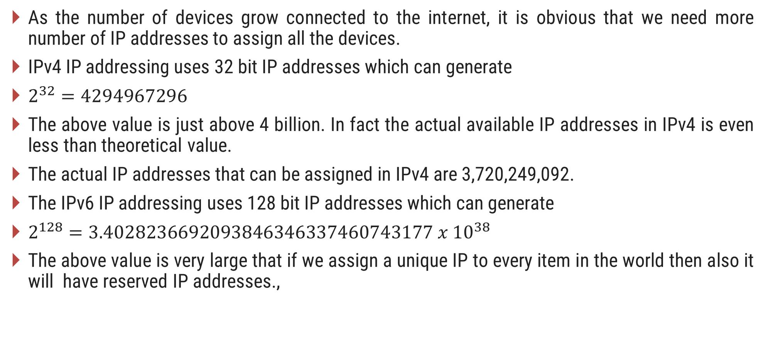
IPv6 Addressing
As the number of devices grow connected to the internet, it is obvious that we need more number of IP addresses to assign all the devices.
IPv4 IP addressing uses 32 bit IP addresses which can generate
$2^{32}=4294967296$
The above value is just above 4 billion. In fact the actual available IP addresses in IPv4 is even less than theoretical value.
The actual IP addresses that can be assigned in IPv4 are 3,720,249,092.
The IPv6 IP addressing uses 128 bit IP addresses which can generate
$2^{128}=3.4028236692093846346337460743177 x {10}^{38}$
The above value is very large that if we assign a unique IP to every item in the world then also it will have reserved IP addresses.,

Slide 74
Features of IPv6 Addressing
It has better and efficient routing than IPv4.
The additional flow label is added in header of IPv6 for improvement in QoS.
IPv6 has new application like IP telephony, video/audio, interactive games etc. with ensured QoS.
The plug and play abilities have been improved in IPv6.
IPv6 has eliminated the need of Network Address Translation due to the huge availability of IP addresses.

Slide 75
IPv6 Header Format
IPv6 header format has less fields than IPv4 header format.
IPv6 header is 40 bytes which is twice than IPv4 header.
The figure shows IPv6 header format.
The IPv6 has simple packet handling and improved forwarding efficiency.
The fields of IPv6 header can be explained as following:
IP Version Number (4) | Traffic Class (8) | Flow Label (20)
Payload Length (16) | Next Header (8) | Hop Limit (8)
Source Address (128)
Destination Address (128)

Slide 76
IPv6 Header Format
IP version :
It is 4 bit field to represent the IP version being used.
Traffic Class :
It is 8 bit field to identify the different classes or priorities of IPv6 packets.
It replaces the type of services in IPv4.
Upper 6 bits are used for type of services lower 2 bits are used for Explicit Congestion Notification.
Flow Label :
It is 20 bit field used to identify the sequence of packets.
It is also useful for prioritizing the delivery of packet and providing real time service.
The higher priority packets can be delivered ahead of lower priority packets.
IP Version Number (4) | Traffic Class (8) | Flow Label (20)
Payload Length (16) | Next Header (8) | Hop Limit (8)
Source Address (128)
Destination Address (128)

Slide 77
IPv6 Header Format
Payload Length :
It is a 16 bit field which identifies the length of payload of IPv6.
Next Header :
It is a 8 bit field which is similar to protocol field in IPv4 header.
It represents the type of extension header that follows the primary IPv6 header.
Hop Limit :
It is 8 bit field equivalent to Time to Live in IPv4 Header.
The value is decremented by 1 every time when it is forwarded by the host.
When this value reaches 0, the packet is discarded.
IP Version Number (4) | Traffic Class (8) | Flow Label (20)
Payload Length (16) | Next Header (8) | Hop Limit (8)
Source Address (128)
Destination Address (128)

Slide 78
IPv6 Header Format
Source Address :
It represents the 128 bit IP address of source or sender.
Destination Address :
It represents the 128 bit IP address of destination or receiver.
IP Version Number (4) | Traffic Class (8) | Flow Label (20)
Payload Length (16) | Next Header (8) | Hop Limit (8)
Source Address (128)
Destination Address (128)

Slide 79
Uniform Resource Identifier (URI)
Uniform Resource Identifier (URI) is used to identify the resources with the help of sequence of characters.
The URI protocol was developed by IETF.
The URI can be URL or URN.
The sample for URL and URN can be as following:
URN mostly provides information of unique name without locating or retrieving the resource information.
URL provides locating and retrieving information on a network.
Universal Resource Locator (URL)
E.g.: https://darshan.ac.in/ce/material
Universal Resource Identifier (URI)
Universal Resource Name (URN)
E.g.: ISBN:0451450523

Slide 80
Uniform Resource Locator (URL)
The URL contains the information of how to fetch a resource information from its location.
URL always begin with a protocol like HTTP/HTTPS
A URL is used when client request the server for the service.
The sample URL and its fields are explained below:
World Wide Web
http://www.darshan.ac.in/CE/Study-material/IoT/Syllabus.html
HTTP Protocol
Domain Name
Path
File name

